Slide 1
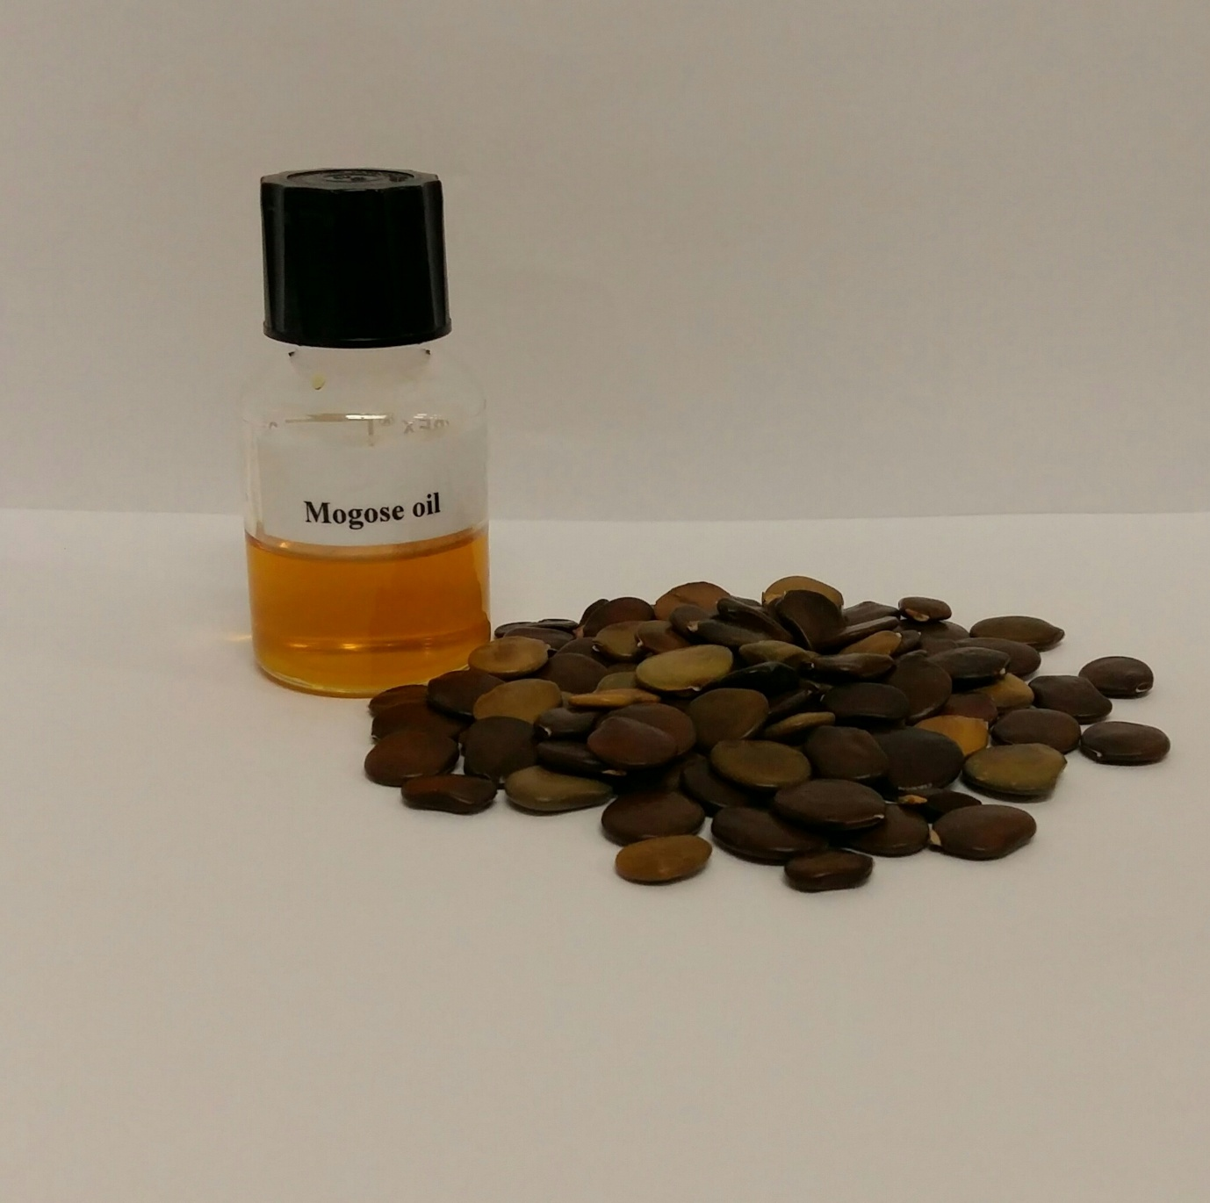
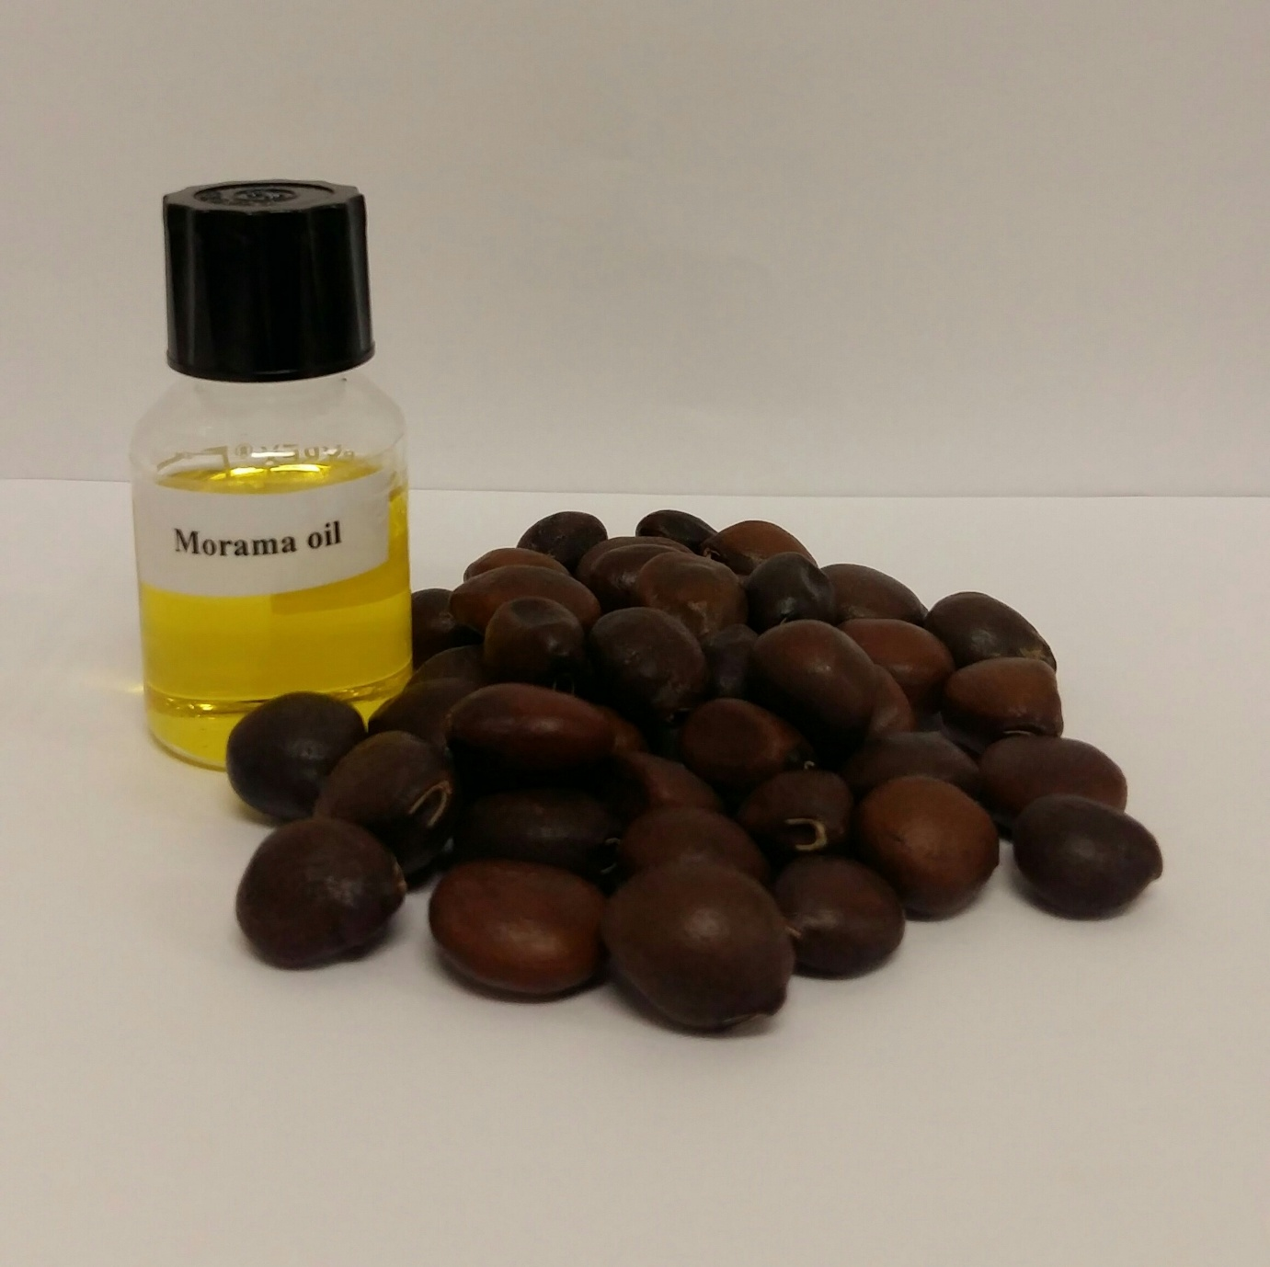
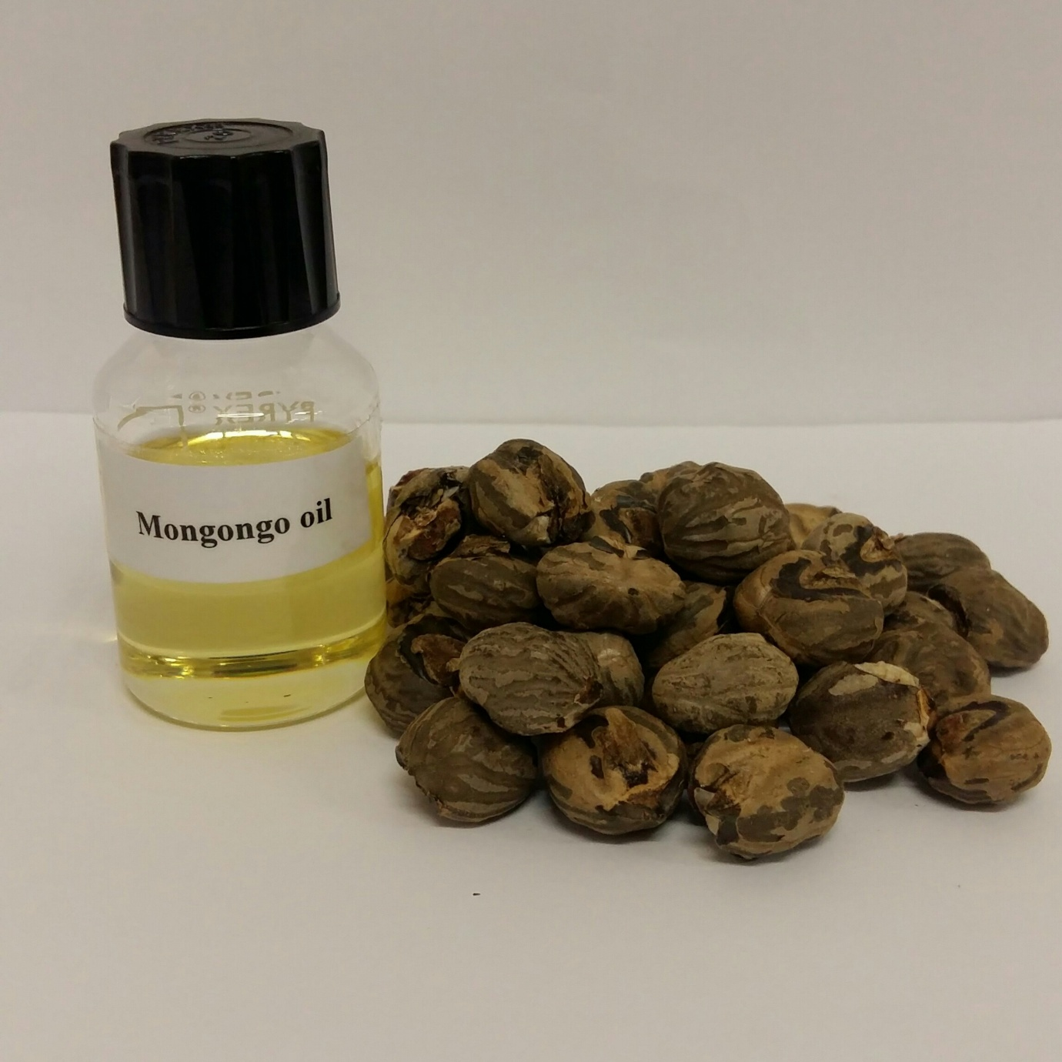
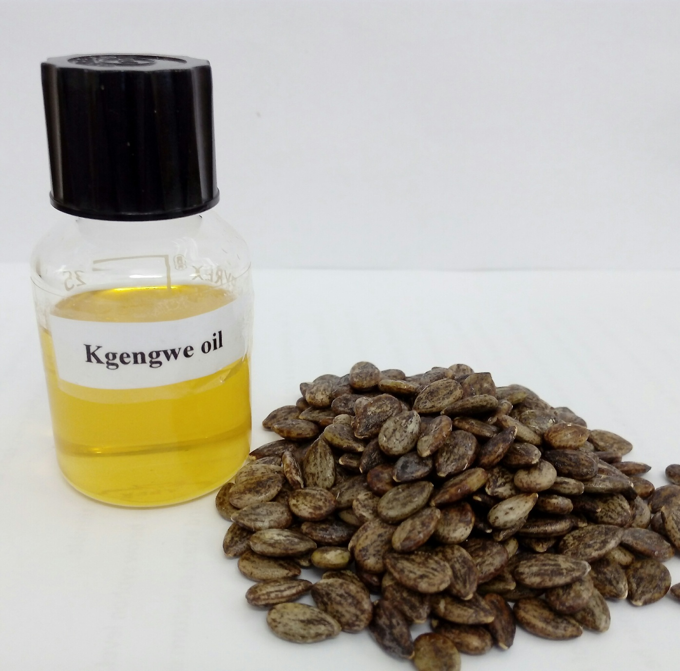
Physicochemical properties of indigenous oil seeds in Botswana
O.K Matenanga¹. E.M.O Yeboah² , R.I Kobue- Lekalake¹ and E Murithii^{1.}
1.Botswana University of Agriculture and Natural Resources P/Bag 0027 Gaborone Botswana
2.University of Botswana P/Bag 0022 Gaborone Botswana
Introduction
Results
Botswana is well endowed with vegetable oil producing plants which are underutilised due to lack of knowledge and information on the quality of the oils extracted from these plants. Among the latter are Mongongo (Schinziophyton rautenenii), Mogose (Bauhinia petersiana), Kgengwe (Citrulus lanatus) and Morama (Tylosema esculentum) .These plants can be used as a solution to food security and improvement of the socio economic status of the rural communities which derive their livelihood from these indigenous resources as food and medicine.
Objective
To determine the physico-chemical properties of the seed oils of four indigenous plants from Botswana namely Mogose, Morama, Mongongo and Kgengwe.
Table 1: Physicochemical characteristics of the oils
Sample | RI (23.1 ^{O}C) | Density (g/mL) | AV (mg KOH/g) | SV (mg KOH/g) | PV (mEq O₂/kg) | IV (g/100 g)
Morama | 1.46± 0.01 | 0.90± 0.01 | 1.16± 0.09 | 150.1± 0.26 | 6.31± 0.23 | 71.7± 6.3
Mungongo | 1.49± 0.01 | 0.91± 0.01 | 0.69± 0.12 | 172.3± 1.71 | 5.12± 0.27 | 150.1± 0.26
Mogose | 1.47± 0.01 | 0.91± 0.01 | 0.91± 0.01 | 167.1± 7.84 | 4.65± 0.47 | 92.0± 6.42
Kgengwe | 1.47± 0.01 | 0.93± 0.01 | 3.27± 0.26 | 182.9± 1.62 | 5.14± 0.49 | 144.2± 1.91
Methods
Total lipid extraction was carried out by solvent extraction using soxhlet apparatus. The chemical parameters of the oils were determined by IUPAC procedures. The refractive indices of the oils were measured using an ATAGO RX5000 refractometer (Tokyo, Japan) attached to Labcon low temperature water bath (23.1 ^{O}C). Densities were measured on an Anton Paar DMA 4500 Density meter (Graz, Austria).
Discussion
The refractive indices (RI) of the oils are within the range of (1.45 and 1.49) as reported by [2] for some oils in the nut family.
Acid value (AV) of oils under study range between 0.69 and 3.27 mg KOH/g, and are comparable with other edible vegetable oils: Shea nut oil (1.2) and Olive (0.3)
The peroxide values (PV) range from 4.65 to 6.3 mEq O₂/ kg which are within the acceptable range as per the Codex Alimentarius standard, making these oils stable against rancidity and oxidation.[1]
Saponification value (SV) of the oils ranges between 167.1 and 182.9 mg KOH/g and are lower than those of common oils such as palm oil (200) and groundnut (193).The oils can still be used for industrial purpose of making soap.
Iodine values (IV) of Mongongo (150.1g/100g) and Kgengwe (144.2g/100g) show a higher degree of unsaturation than Morama and Mogose which had 71.7 and 92 g /100g respectively.
Mogose (Bauhinia petersiana)
Morama (Tylosema esculentum)
Conclusions
Generally the oils under study compare very well in terms of quality with oil bearing plants such as Shea, Soya, olive and palm, therefore can be used as edible oils and for industrial purposes.
Recommendation would be to conduct value addition and commercialisation of the different oils.
References
1.Codex Alimentarius (210, 2003). Food and Agricultural Organization, FAO publishers, Rome, Codex Standard for edible fats and oils : Codex Stan 19-1981. Retrieved from website www.codexalimentarius.net/standard on August 15, 2016
2. Eckey E.W (1954). Vegetable Fats and Oil, Reinhold Publishing Corp., pp. 407-426
Mongongo(Schinziophyton rautenenii)
Kgengwe (Citrulus lanatus)
Figure 1: Study material
Contact: O.K Matenanga
Email:matenangakeo@gmail.com

